Slide 1

Travel Management System
GROUP MEMBERS
Kalyan Venkat Madireddy
Rohith Guptha Kona
Vamshi Reddy Konuganti
Tarun Akasapu

Slide 2
INTRODUCTION :-
Technology has transformed the way we purchase everyday items, it has also revolutionized the way we plan and book our travel arrangements
The rise of online travel agencies and the ability to book flights, hotels, and rental cars at the click of a button has made travel more accessible than ever before.
However, with so many options available, it can be overwhelming for consumers to navigate the vast array of choices and find the best deals.
Notes:
The internet has not only changed the way we shop for necessities but also how we schedule vacations.
The convenience of online travel firms and the availability of instantaneous reservations for lodging, transportation, and sightseeing has lowered barriers to travel.
The plethora of choices available, however, can make it difficult for customers to zero in on the best prices.

Slide 3
INTRODUCTION [ Cont’d ] :-
That's where our travel management system comes in - a comprehensive platform that simplifies the process of booking travel and empowers consumers to make informed decisions.
Our system offers a user-friendly interface, personalized recommendations, and real-time updates to ensure a seamless and stress-free travel experience.
With our system, travelers can focus on what really matters - enjoying their journey and making lasting memories.
Notes:
Our travel management system is a full-featured hub that streamlines the trip-planning procedure and gives customers more control over their vacation plans.
Our system's intuitive UI, tailored suggestions, and constant updates provide for a trouble-free and enjoyable trip.
With our system,vacationers won't have to worry about the little things and can instead concentrate on generating memories to last a lifetime.

Slide 4
PROBLEM STATEMENT :-
The problem we are addressing is the inefficiency and complexity of travel planning and management, which can result in wasted time, increased expenses, and decreased traveler satisfaction.
Current methods of travel planning often involve waiting in long lines for tickets, managing multiple reservations across different modes of transportation, and manually tracking travel expenses. This can be overwhelming and error-prone, leading to missed opportunities and unnecessary costs.
Notes:
The problem we are solving is the inefficiency and complexity of travel planning and management, which can result in wasted time, increased expenses, and decreased traveler satisfaction. Traditional methods of travel planning involve long lines, managing multiple reservations, and manually tracking expenses, which can be overwhelming and prone to errors, leading to missed opportunities and unnecessary costs.

Slide 5
PROPOSED METHODS :-
The proposed Travel Management Application is designed to simplify the process of booking various modes of transportation by providing a single platform for users.
The application will have a user-friendly interface that allows users to easily sign up, log in, and book tickets by specifying their preferences.
Upon completion of the booking process, the application will generate a PDF itinerary that can be saved for future reference.
Notes:
The Travel Management Application aims to simplify the booking process for different modes of transportation by providing a single platform for users. It will have a user-friendly interface that enables users to sign up, log in, and book tickets easily by specifying their preferences. After booking, the application will generate a PDF itinerary that can be saved for future reference.

Slide 6
FUNCTIONAL REQUIREMENTS :-
Customer should be able to book the itinerary using the website.
Customer must be able to pay for the itinerary using his choice of payment method. .
The System should allow the customers to manage their Travel booking. .
The system should allow the customers to either register themselves or login.
The system should allow users to choose their choice of booking based on their budget, planning and comfort.
The System should be able to generate the printable format of the ticket.
Notes:
The system should allow customers to book their itinerary and pay using their preferred payment method through the website. Customers should also be able to manage their bookings, either by registering or logging in. The system should enable users to choose their preferred booking based on their budget, planning, and comfort. Additionally, the system should generate a printable ticket format.

Slide 7
NON FUNCTIONAL REQUIREMENTS :-
The Website needs to be fast and respond to the actions from the user correctly.
The UI has to be simple and aid in the process of booking rather than simply confusing the user.
The website must be available all the time and should work without any bugs.
The system must be secure and prevent any data privacy concerns, which can be achieved using the login page that allows the customer to set a password for their accounts.
Notes:
The website must be fast and responsive to user actions while having a simple and user-friendly interface that helps the user through the booking process. It should be available at all times, working without any bugs, and ensure data privacy through a secure login page that allows customers to set passwords for their accounts.

Slide 8
COMPUTATIONAL RESOURCES :-
Hardware Configurations:
Any Operating System
Minimum 4GB RAM
Minimum 4GB Disk Space
Client Side Technologies:
Html,CSS,JavaScript
Kotlin
Software Configurations:
IntelliJ IDE 2022.3.2
Mysql Workbench 8.0
Sublime 2022 Version
Chrome/Brave browsers
Notes:
Here are the certain limtations of our syustem like where it works and not works, the hardware and software configurations

Slide 9
Why Kotlin ?- Language Paradigm (Multi-Paradigm)
Programming language Kotlin adopts a multi-paradigm approach to software development, giving developers a wide variety of tools and strategies to address challenging issues.
Kotlin provides a flexible and adaptable foundation for developing software in a variety of scenarios by mixing components of reactive programming, procedural programming, functional programming, and object-oriented programming.
The object-oriented programming capabilities of Kotlin, at their core, offer a potent means to encapsulate data and action within reusable code structures, making it simpler to create and maintain applications over time.
Notes:
Kotlin is a programming language that takes a multi-paradigm approach to software development. It combines different programming techniques like reactive, procedural, functional, and object-oriented programming to provide developers with a wide variety of tools to address complex problems. Kotlin's object-oriented programming capabilities allow for data and actions to be encapsulated within reusable code structures, making it easier to develop and maintain applications over time. Overall, Kotlin provides a flexible and adaptable foundation for developing software in various scenarios. That’s give kotlin an upper hand.

Slide 10
Historical Evolution
2011- JetBrains, a software development firm, announces the invention of Kotlin, a new programming language.
2013- the introduction of Kotlin's initial version (1.0), which supported Android and Java development.
2016- Google officially embraces Kotlin on Android, which improved the language's uptake among those working in the mobile development industry.
2020-Kotlin Multiplatform Mobile (KMM), a framework for creating cross-platform mobile apps using Kotlin, is released by JetBrains.
2023- Kotlin 1.8 has been published, featuring a new -Xdebug compiler option, improved Objective-C/Swift interoperability, and compatibility with Gradle.
Notes:
Kotlin’s initial release was in 2011, its open-source launch in 2012, and its increasing adoption in mobile development with the support of Google in 2016. The passage also notes several major updates to the language, including the introduction of coroutines and cross-platform programming support in 2017 and 2018 respectively. The more recent updates include the release of Kotlin Multiplatform Mobile (KMM) in 2020, and the launch of Kotlin 1.5 and 1.7 in 2021 and 2022 respectively, with new features such as sealed interfaces and improved compatibility with Gradle. Finally, Kotlin 1.8 is mentioned as the upcoming release, which includes new features such as improved interoperability with Objective-C/Swift and a new -Xdebug compiler option.

Slide 11
Kotlin Known for ?
Simplicity - Easy to learn and write, using a minimal set of straightforward syntactic rules.
Concurrency- Concurrent and parallel programming are supported natively, allowing for effective utilization of existing hardware.
Performance- Converts to machine code for quick and effective execution.
Scalability - Suitable for developing distributed applications and large-scale systems.
Notes:
As shown here, Kotlin is SImple, Concurrent, Scalable and Performance oriented language. Kotlin is a programming language with a simple syntax that is easy to learn and write. Hence simple. It supports concurrent and parallel programming and converts to machine code for fast execution, making it great performant. Additionally, it is suitable for developing distributed applications and large-scale systems, making it scalable.

Slide 12
KOTLIN :-
Kotlin Elements: Basic Data Types -> Numbers, booleans, Strings, Arrays and Characters.
Variables with specific rules for naming ad two types with var and val type.
Different type of Operators: Arithmetic Operators, Assignment Operators, Comparison Operators, Logical Operators, Bitwise Operators.
Control Statements: Conditional Statements : If, If-else and when
Looping Statements: For loop, while loop and do while loop
Jump Statements: Break and continue
Functions: Standard library functions and User defined functions with arguments
Classes and inheritance support
Packages and Modules
Notes:
Kotlin like any other programming languages have basic element data types like numbers, booleans, strings, arrays and characters. And also the naming variables has certain rules, the difference between other languages and this is that, here the variables are of two types the one which we can’t change and the ones we can change, which are differentiated using the key words var and val. Kotlin also support the use of different types of operators. Conditional statements, looping statements,jump statements are all supported by the kotlin. Kotlin does have some functions reserved for certain operations like println() and all. And also Kotlin supports the import of packages, modules, inheritance through classes showing strong object oriented properties.

Slide 13
KOTLIN Stand out Features :-
Conciseness: Kotlin is a highly expressive language that allows developers to write more concise and readable code. This makes it easier to understand and maintain code, and reduces the likelihood of errors.
Null safety: Kotlin has a strong type system that makes it impossible to assign null values to non-nullable variables. This eliminates a common source of errors in Java programs, where null pointer exceptions can cause crashes and other problems.
Interoperability with Java: Kotlin is fully interoperable with Java, meaning that developers can use existing Java libraries and frameworks in Kotlin projects, and vice versa.
Extension functions: Kotlin allows developers to extend existing classes with new functionality, without having to modify the original class. This makes it easier to add new features to code, and reduces the need for boilerplate code.
Coroutines: Kotlin includes support for coroutines, which are a lightweight concurrency mechanism that make it easier to write asynchronous code. Coroutines simplify the process of managing threads and asynchronous tasks, and can lead to more efficient and responsive applications.
Functional programming features: Kotlin includes many features of functional programming, such as lambdas, higher-order functions, and immutability. This makes it easier to write code that is more concise, reusable, and testable.
Notes:
Kotlin offers many modern features that make it a popular choice for application development.
One of the key features of Kotlin is its conciseness. Kotlin is a highly expressive language that allows developers to write more concise and readable code. This makes it easier to understand and maintain code, and reduces the likelihood of errors. Additionally, Kotlin offers null safety, which is a major improvement over Java. Kotlin's strong type system makes it impossible to assign null values to non-nullable variables. This eliminates a common source of errors in Java programs, where null pointer exceptions can cause crashes and other problems.
Another important feature of Kotlin is its interoperability with Java. Kotlin is fully interoperable with Java, meaning that developers can use existing Java libraries and frameworks in Kotlin projects, and vice versa. This makes it easy for developers to adopt Kotlin without having to rewrite their entire codebase.
Kotlin also includes support for coroutines, which are a lightweight concurrency mechanism that make it easier to write asynchronous code. Coroutines simplify the process of managing threads and asynchronous tasks, and can lead to more efficient and responsive applications. Additionally, Kotlin includes many features of functional programming, such as lambdas, higher-order functions, and immutability. These features make it easier to write code that is more concise, reusable, and testable.

Slide 14
Kotlin- Writability ,Readability and Reliability:
Writability: Because of its short syntax and expressive features, Kotlin is a highly writable language. Developers may build code that is both efficient and manageable by using current programming ideas such as lambda expressions and extension functions.
Readability: Kotlin places a high value on readability, and its syntax is meant to be compact and expressive, making code more readable and understandable.
Reliability: Because of its robust type system and null-safety features, Kotlin is a very trustworthy language. The type system of the language guarantees that variables are only allocated values of their specified type, lowering the possibility of mistakes due to type mismatches.
Notes:
The main points are: Writability: Kotlin has a concise syntax and modern programming features like lambda expressions and extension functions, which makes it easy to write efficient and maintainable code. Readability: Kotlin values readability, and its syntax is designed to be expressive and compact, making code more understandable. Reliability: Kotlin has a strong type system and null-safety features, which makes it a reliable language. Its type system ensures that variables are assigned only values of their designated type, reducing the likelihood of errors caused by type mismatches.

Slide 15
Pro’s and Con’s of Kotlin Language:-
PRO’s
CON’S
Syntax that is both concise and expressive
Type inference cuts down on boilerplate code.
Runtime errors are reduced by using null safety mechanisms.
Java code interoperability
Outstanding tooling and IDE support
Smart casting for more efficient and succinct type checking
Simple interaction with Android Studio and programming.
Compilation time is longer as compared to Java.
When compared to Java, there is a smaller community and less resources.
In comparison to Java, there is less support for several frameworks, libraries, and tools.
Because the language evolved swiftly, there is considerable discrepancy in syntax and features.
The standard library is not as large as that of Java.
Notes:
Kotlin's syntax is concise and expressive, with type inference reducing boilerplate code and null safety mechanisms reducing runtime errors. It also has good interoperability with Java and outstanding tooling and IDE support, including smart casting for efficient type checking and easy integration with Android Studio. However, Kotlin's compilation time is longer than Java's, and its community and resources are smaller. Additionally, there is less support for some frameworks, libraries, and tools, and the language has evolved rapidly, leading to discrepancies in syntax and features.

Slide 16
How Kotlin has made it hard/easy to Implement :-
As a developer who has used Kotlin to create a project, I can certainly tell that the language has greatly simplified the implementation process. One of Kotlin's main advantages is its simple and clear syntax.
The grammar of the language is remarkably similar to that of Java, making the switch to Kotlin simple for Java developers.
Furthermore, the type inference feature of the language saves a lot of time because the developer does not have to explicitly describe the data type of variables.
Another key advantage is Kotlin's compatibility with Java. Using Java libraries in Kotlin projects and vice versa reduces the need for developers to rebuild whole codebases, saving time and effort.
Notes:
Having used Kotlin to build our project, I can attest to the language's effectiveness in streamlining the development process. Kotlin's straightforward syntax is a major benefit.
Kotlin's grammar is extremely close to Java's, making the transition easy for Java programmers.
The time savings from not having to explicitly describe the data type of variables is further augmented by the language's type inference functionality.
Kotlin's interoperability with Java is another significant benefit. Developers can save time and avoid code duplication by using Java libraries in Kotlin projects and vice versa.

Slide 17

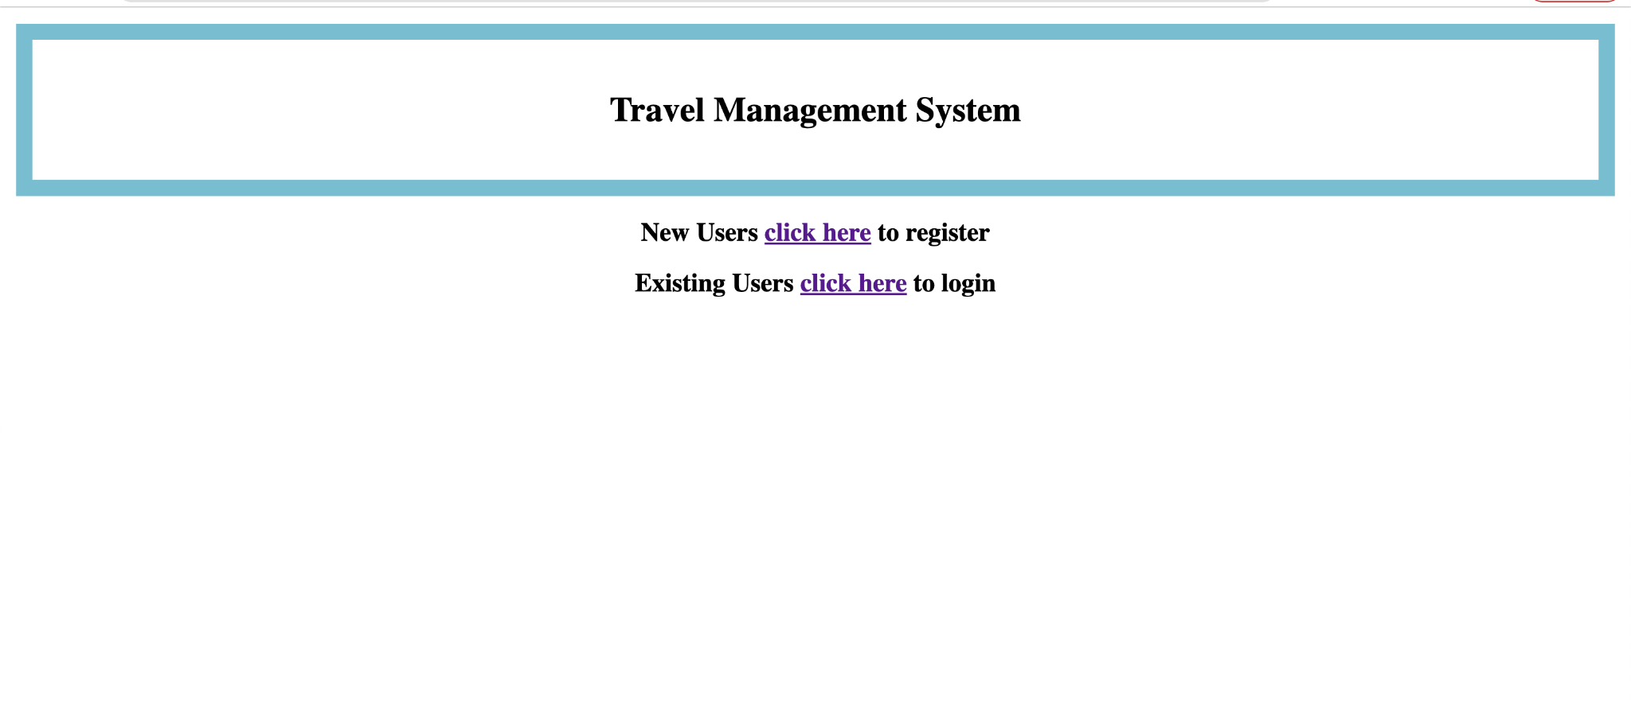
TRAVEL MANAGEMENT SYSTEM SITE:-
INDEX PAGE:-

Slide 18
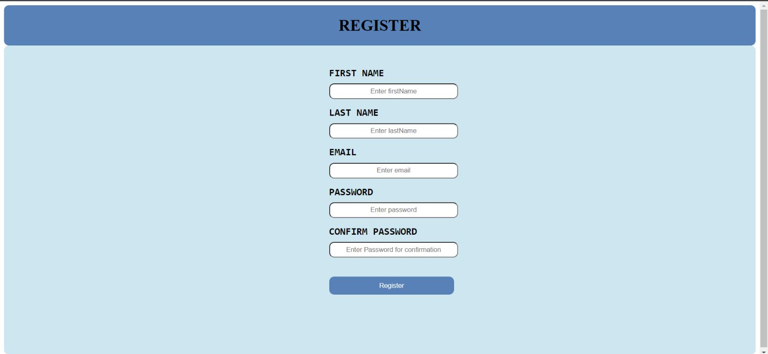
REGISTER PAGE :-

Slide 19

LOGIN PAGE :-

Slide 20
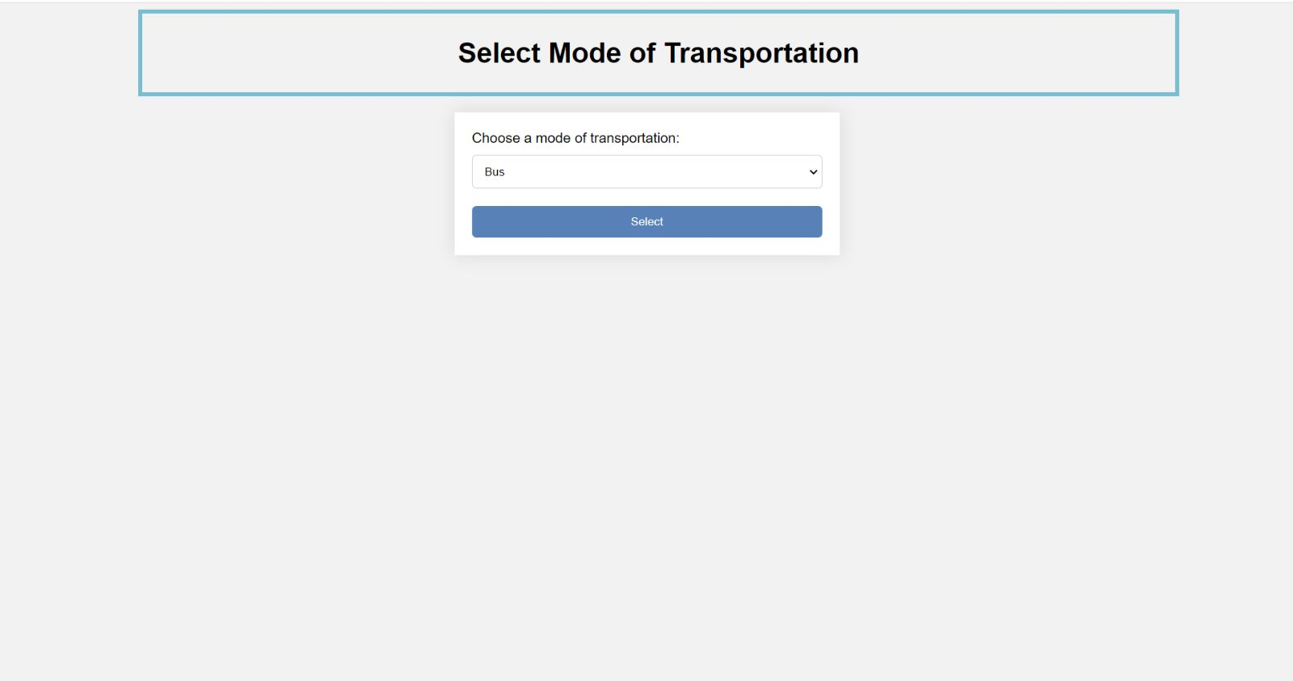
Selecting Mode of Transportation Page:

Slide 21

Finding Buses/Trains/Flights:

Slide 22
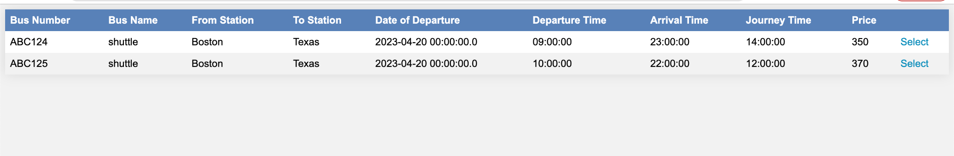
Displaying Buses/Trains/Flights:

Slide 23
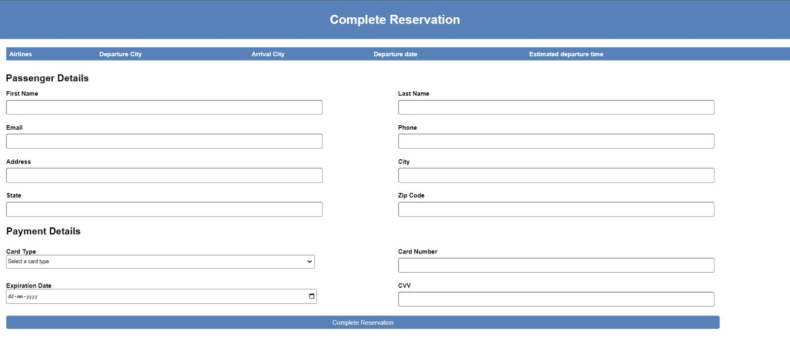
Reservation Page:

Slide 24
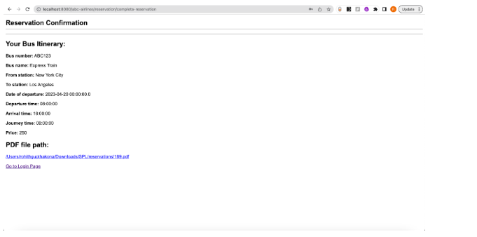
Itenary:

Slide 25
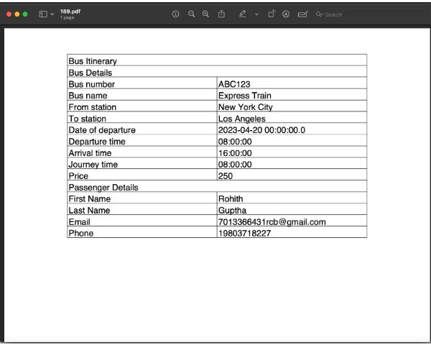
Itenary PDF File:

Slide 26
Conclusion:
The proposed Travel Management System simplifies the process of booking different modes of transportation in a user-friendly way. Its intuitive interface allows users to save time and avoid errors while booking tickets. The system's ability to generate an itinerary in PDF format adds to its convenience. Overall, the Travel Management System is an efficient and effective solution for travel planning and management.
Notes:
Overall, the Travel Management System is an efficient and effective solution for travel planning and management. It simplifies the booking process, saves time, and reduces the risk of errors, making it an ideal choice for travelers looking for a hassle-free way to book their transportation.

Slide 27
THANK YOU

